Slide 1

Knot Theory
수학과 김종근

Slide 2



What is a knot?

Slide 3
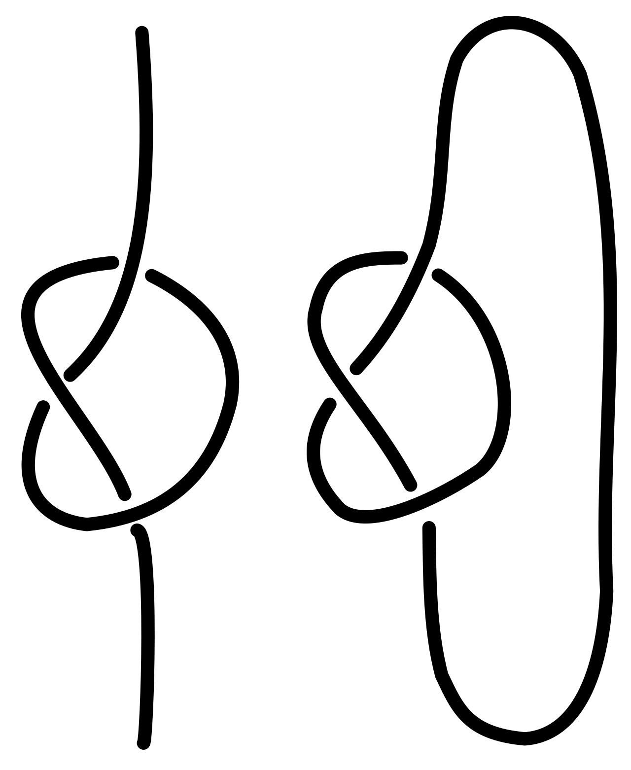
What is a knot ‘in math’?

Slide 4
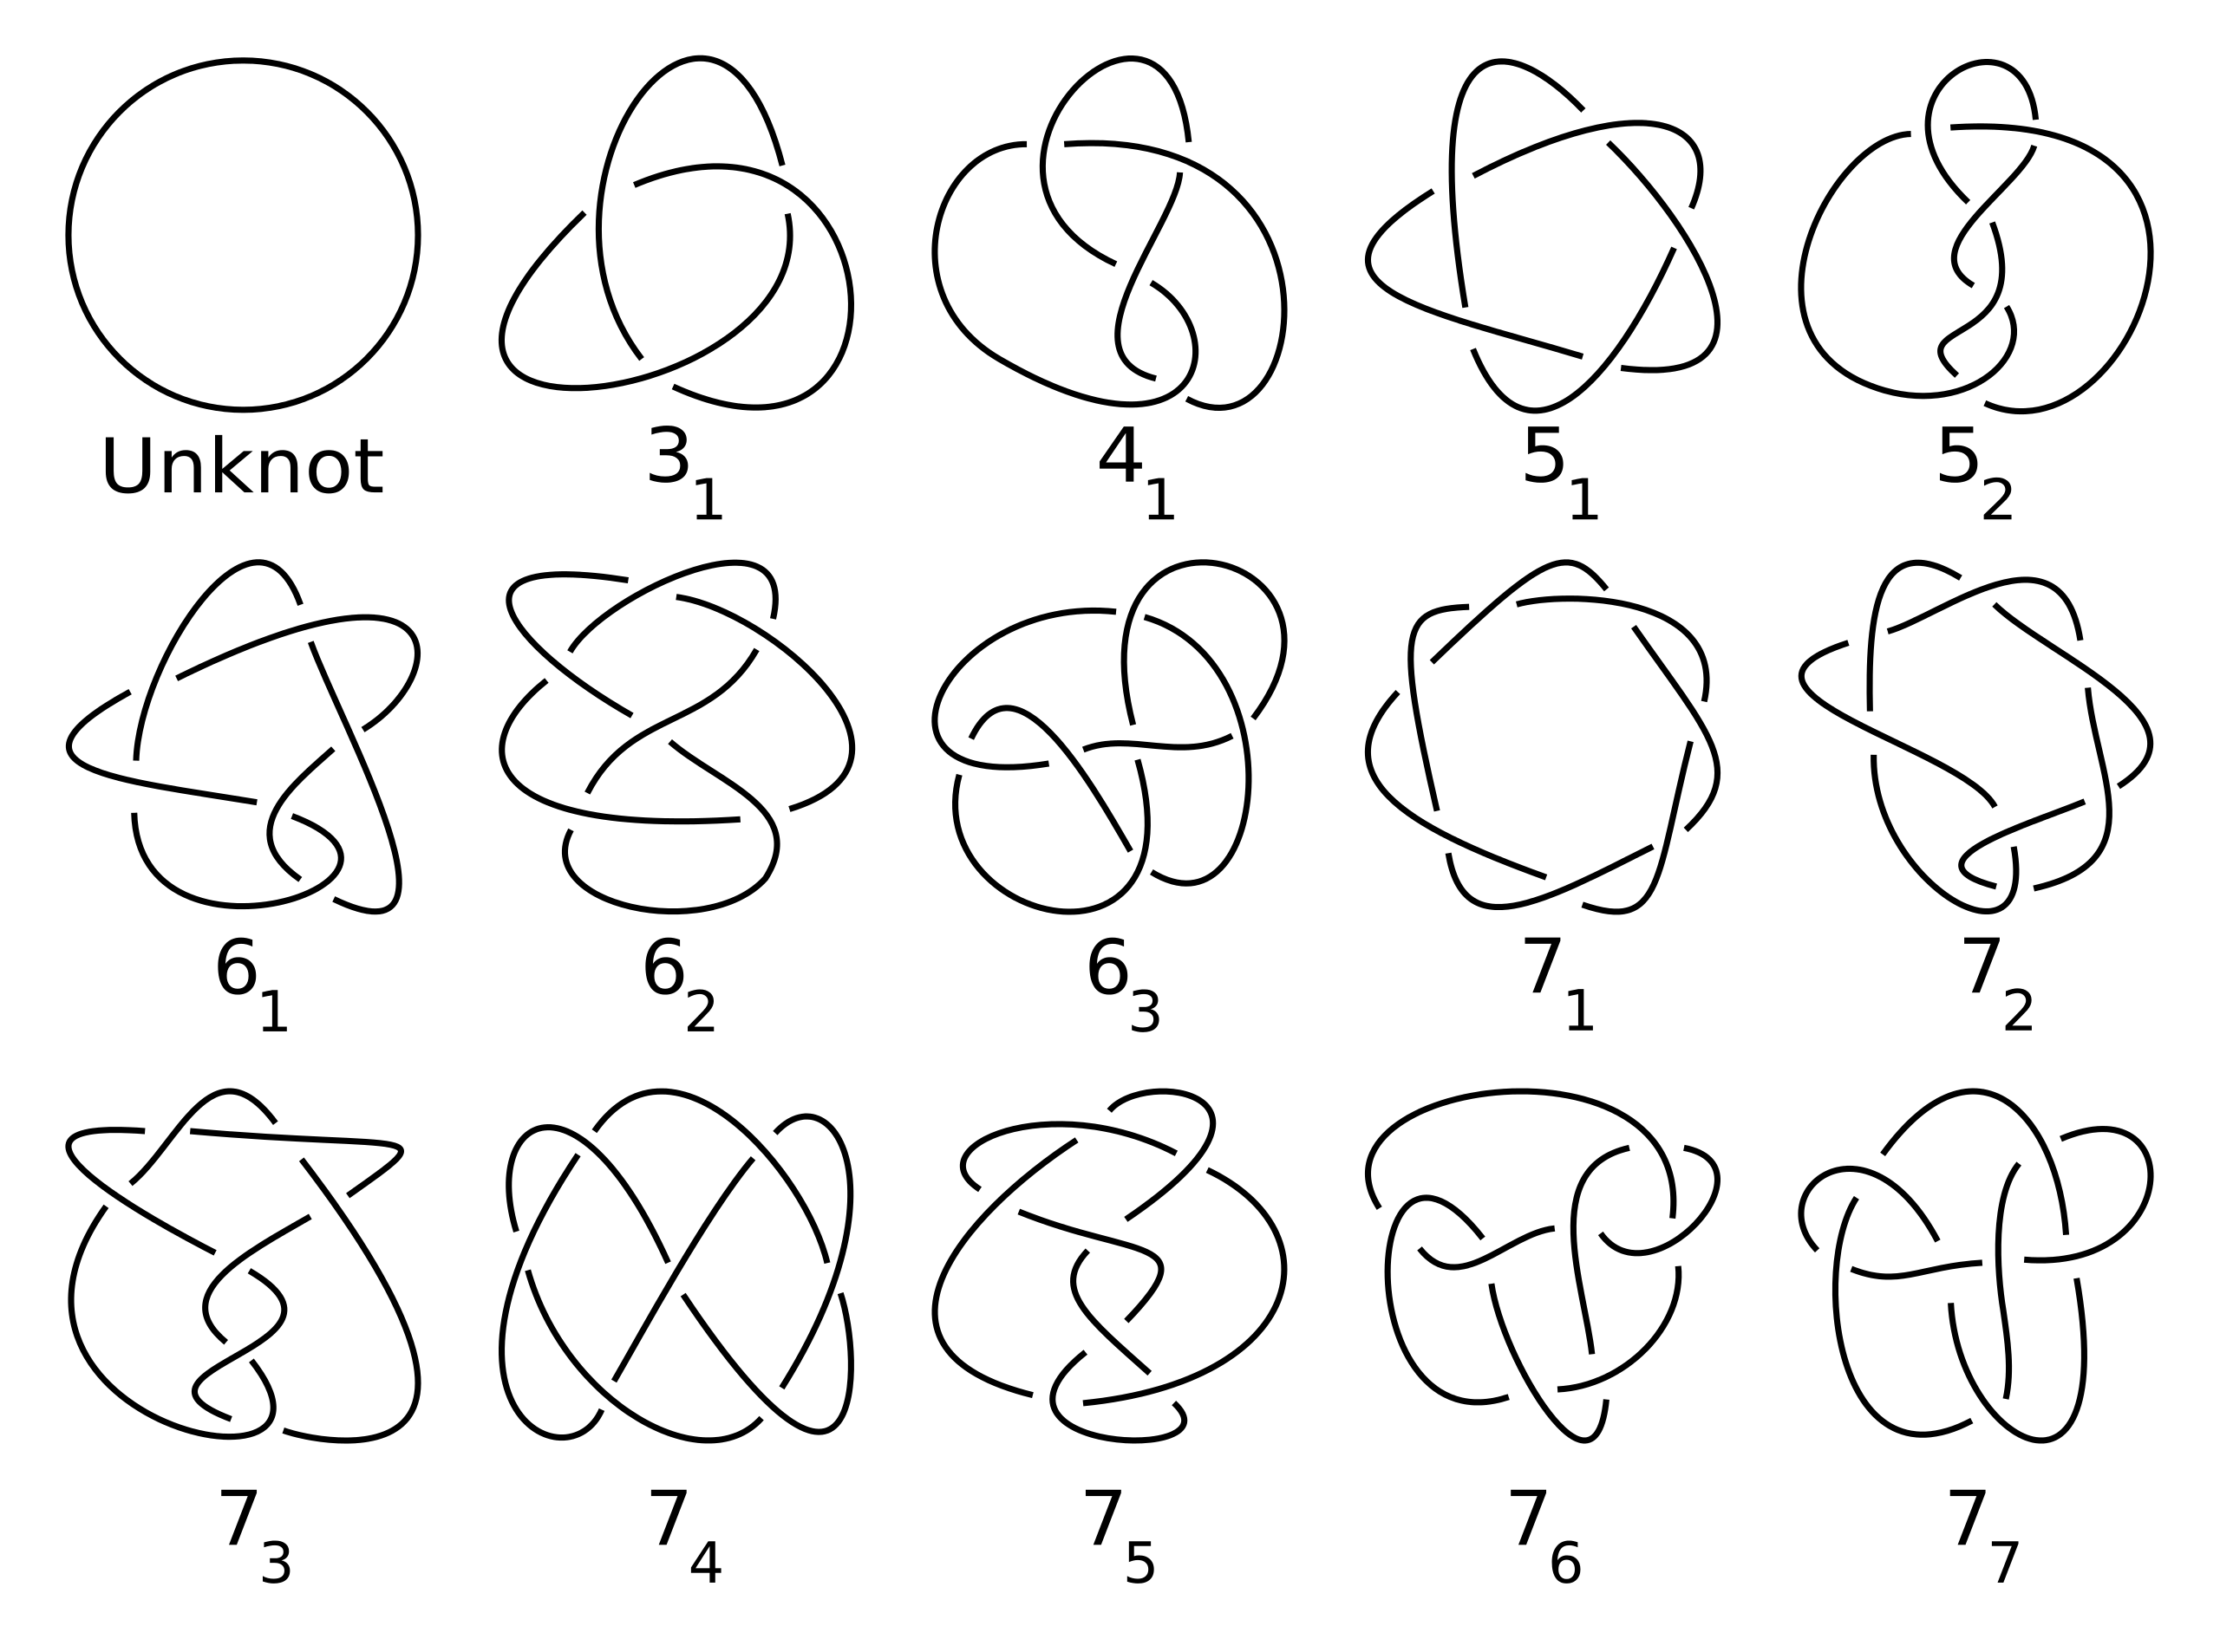
Examples of Knots

Slide 5
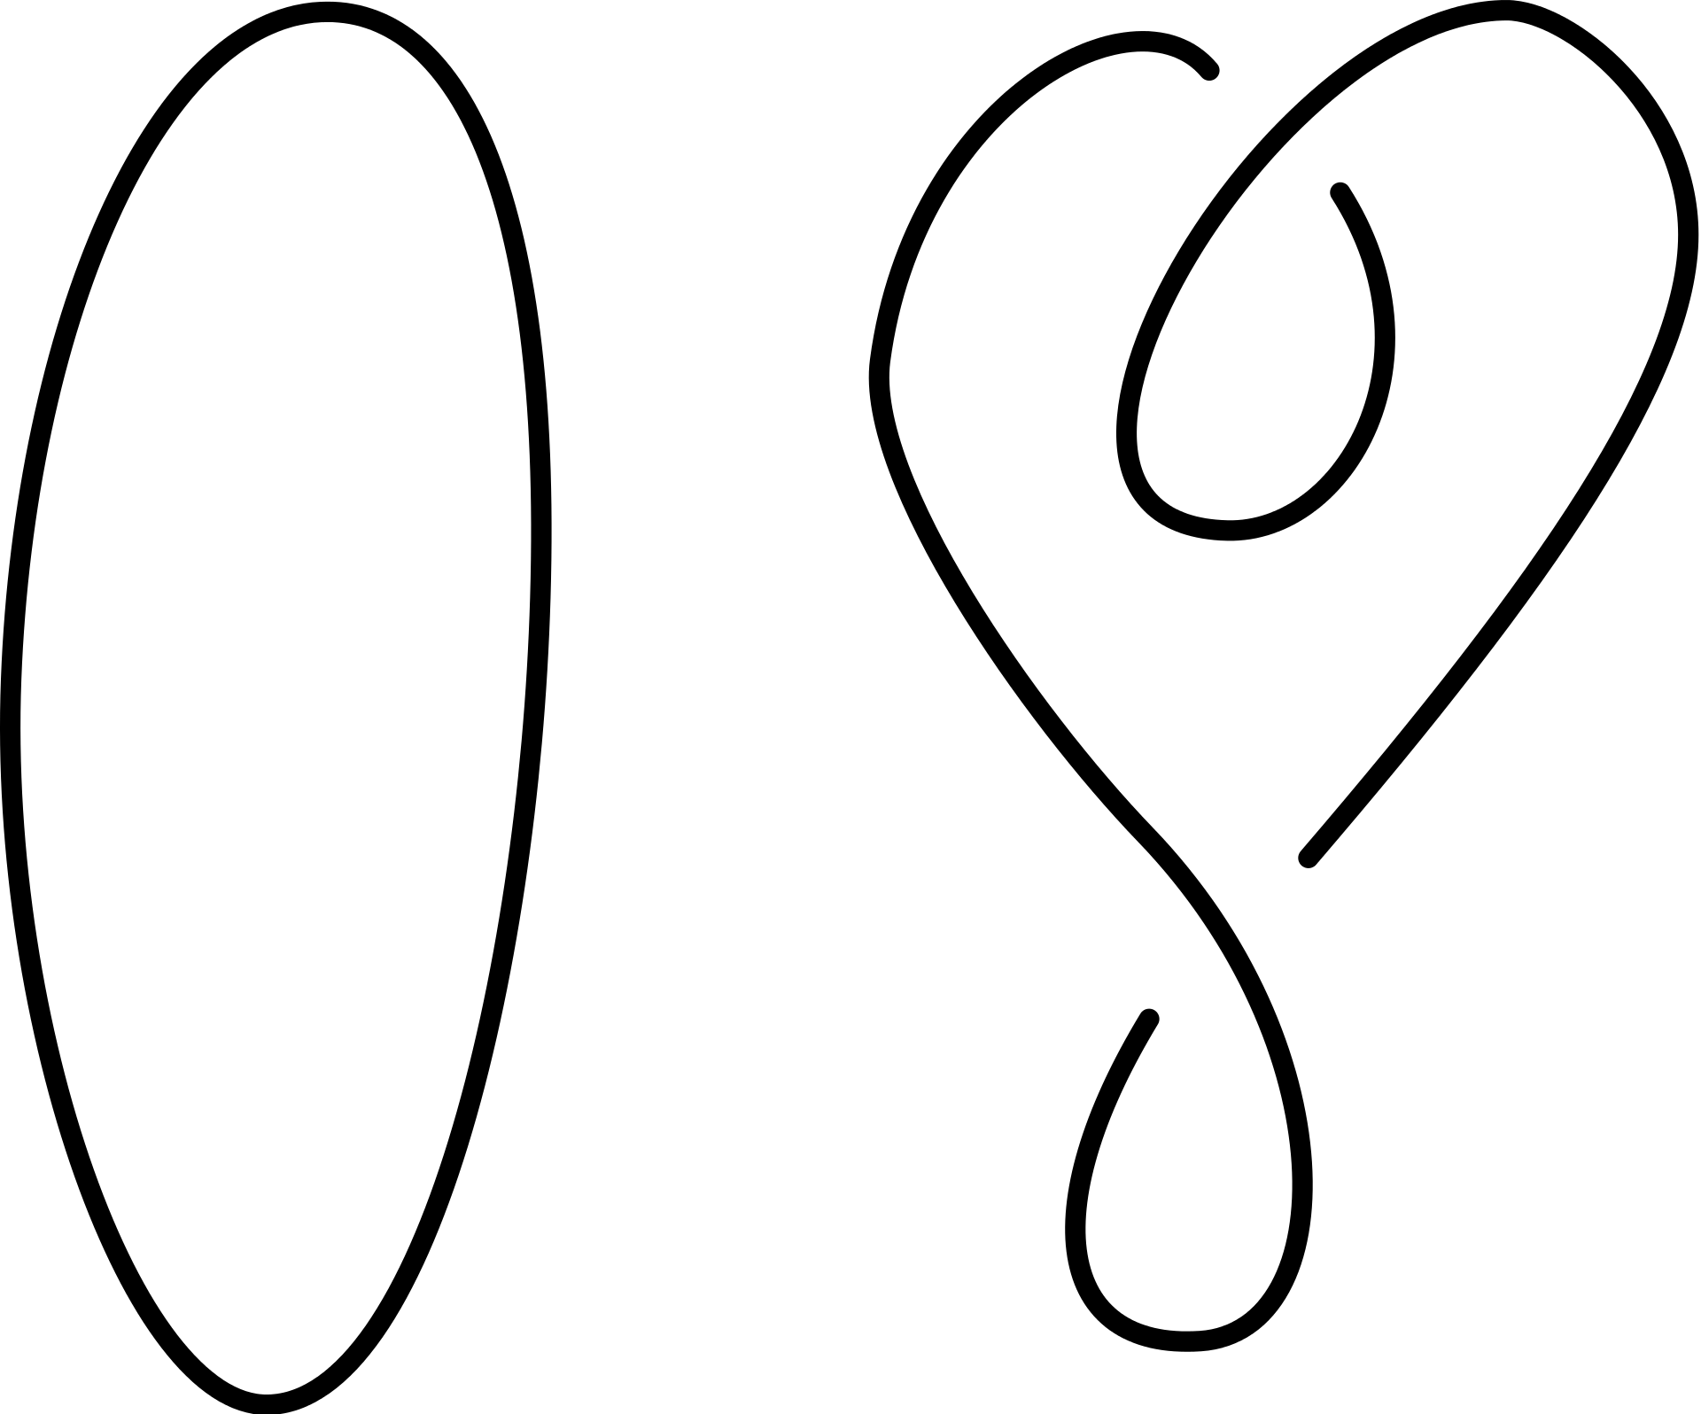
One of the main goals in Knot Theory : Knot equivalence problem
?
=

Slide 6
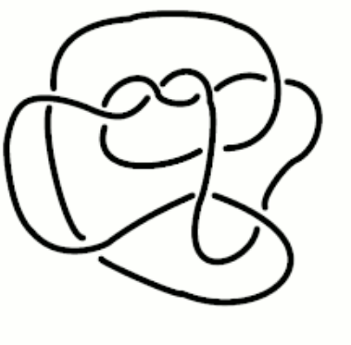
Are two knots equal?
?
=

Slide 7
What does ’Two knots are equal’ mean?

Slide 8



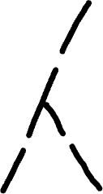





Reidemeister move
Type 1
Type 2
Type 3

Slide 9

Example of Reidemeister move

Slide 10

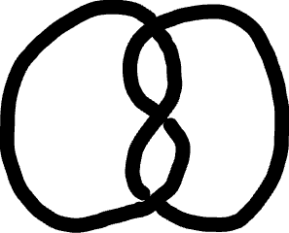
Let’s do it!

Slide 11



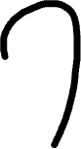


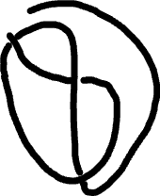




Slide 12

Can we prove two knots are not equal?
?
=

Slide 13
Knot Invariant
Same knot -> Same value
Not same value -> Not same knot

Slide 14




Tricolorability
Rules
At least 2 colors
All same/different color at each crossing

